Slide 1
Science Writing for Broad Audiences
Techniques to increase public awareness of and interest in science through ASU’s monthly newsletter, the SESE Source

Slide 2
ASU’s SESE Source
Monthly newsletter distributed to faculty, undergraduates, graduate students, alumni, staff, potential donors, and people in the community interested in science
Aims to educate, entertain, and inform
Articles focus on research conducted at ASU’s SESE or information relevant to SESE activities

Slide 3
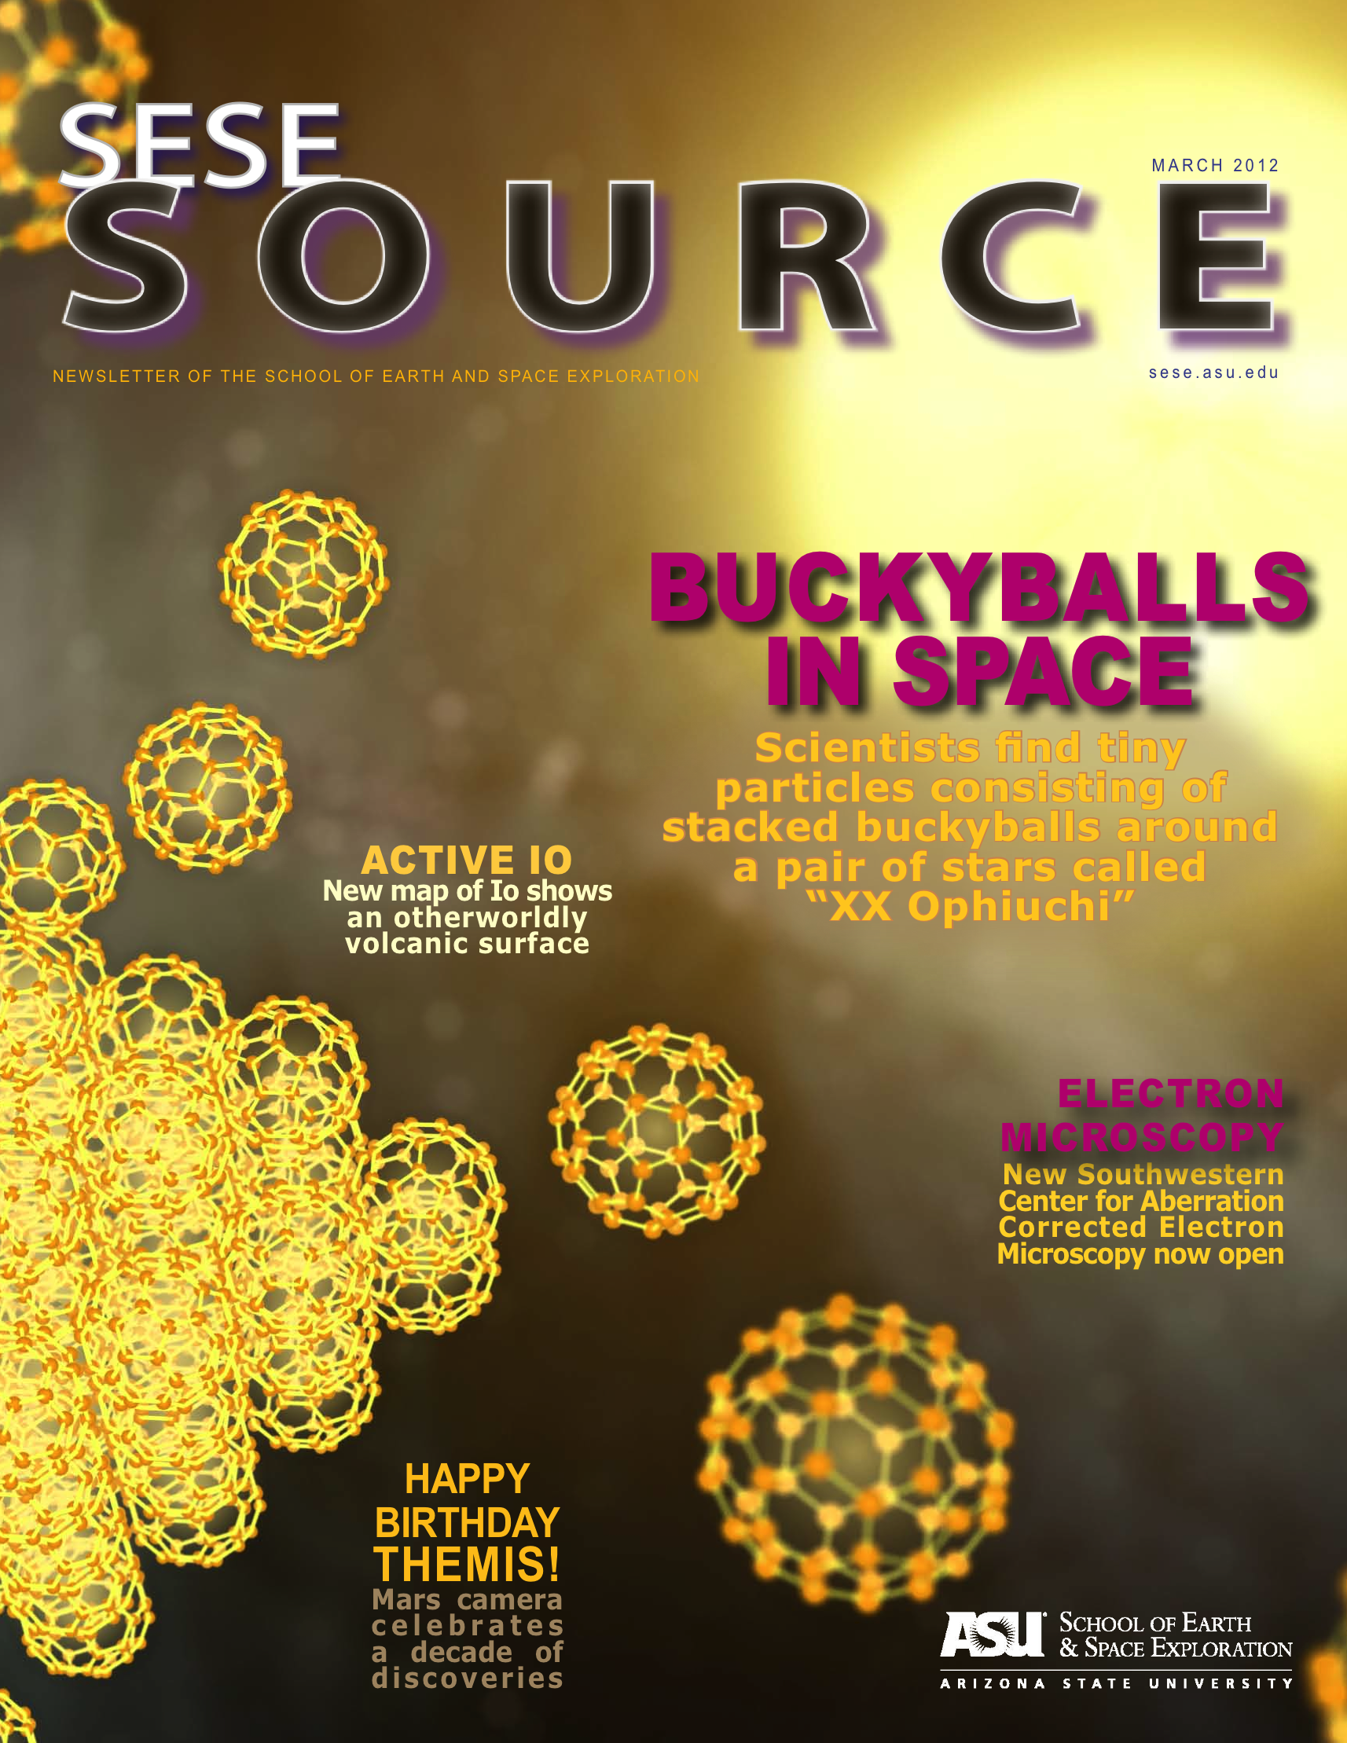
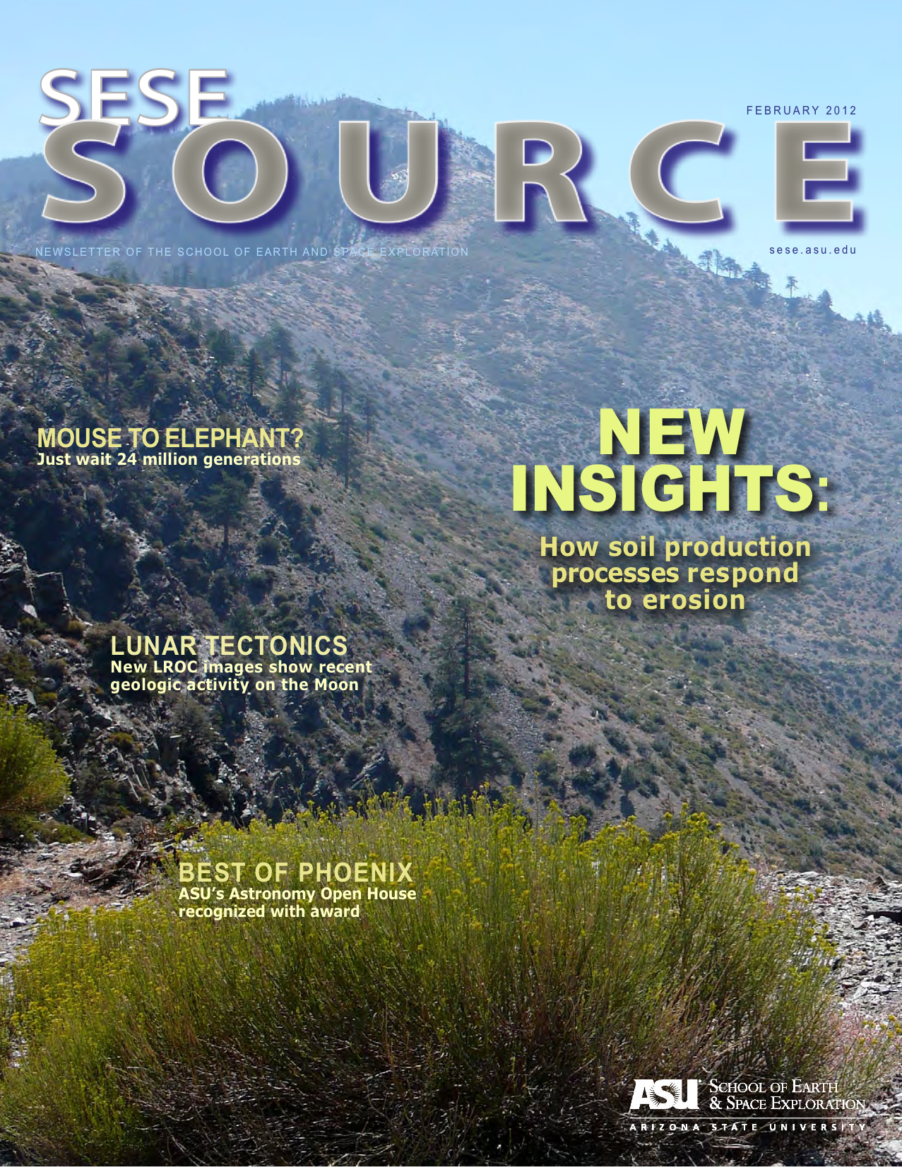
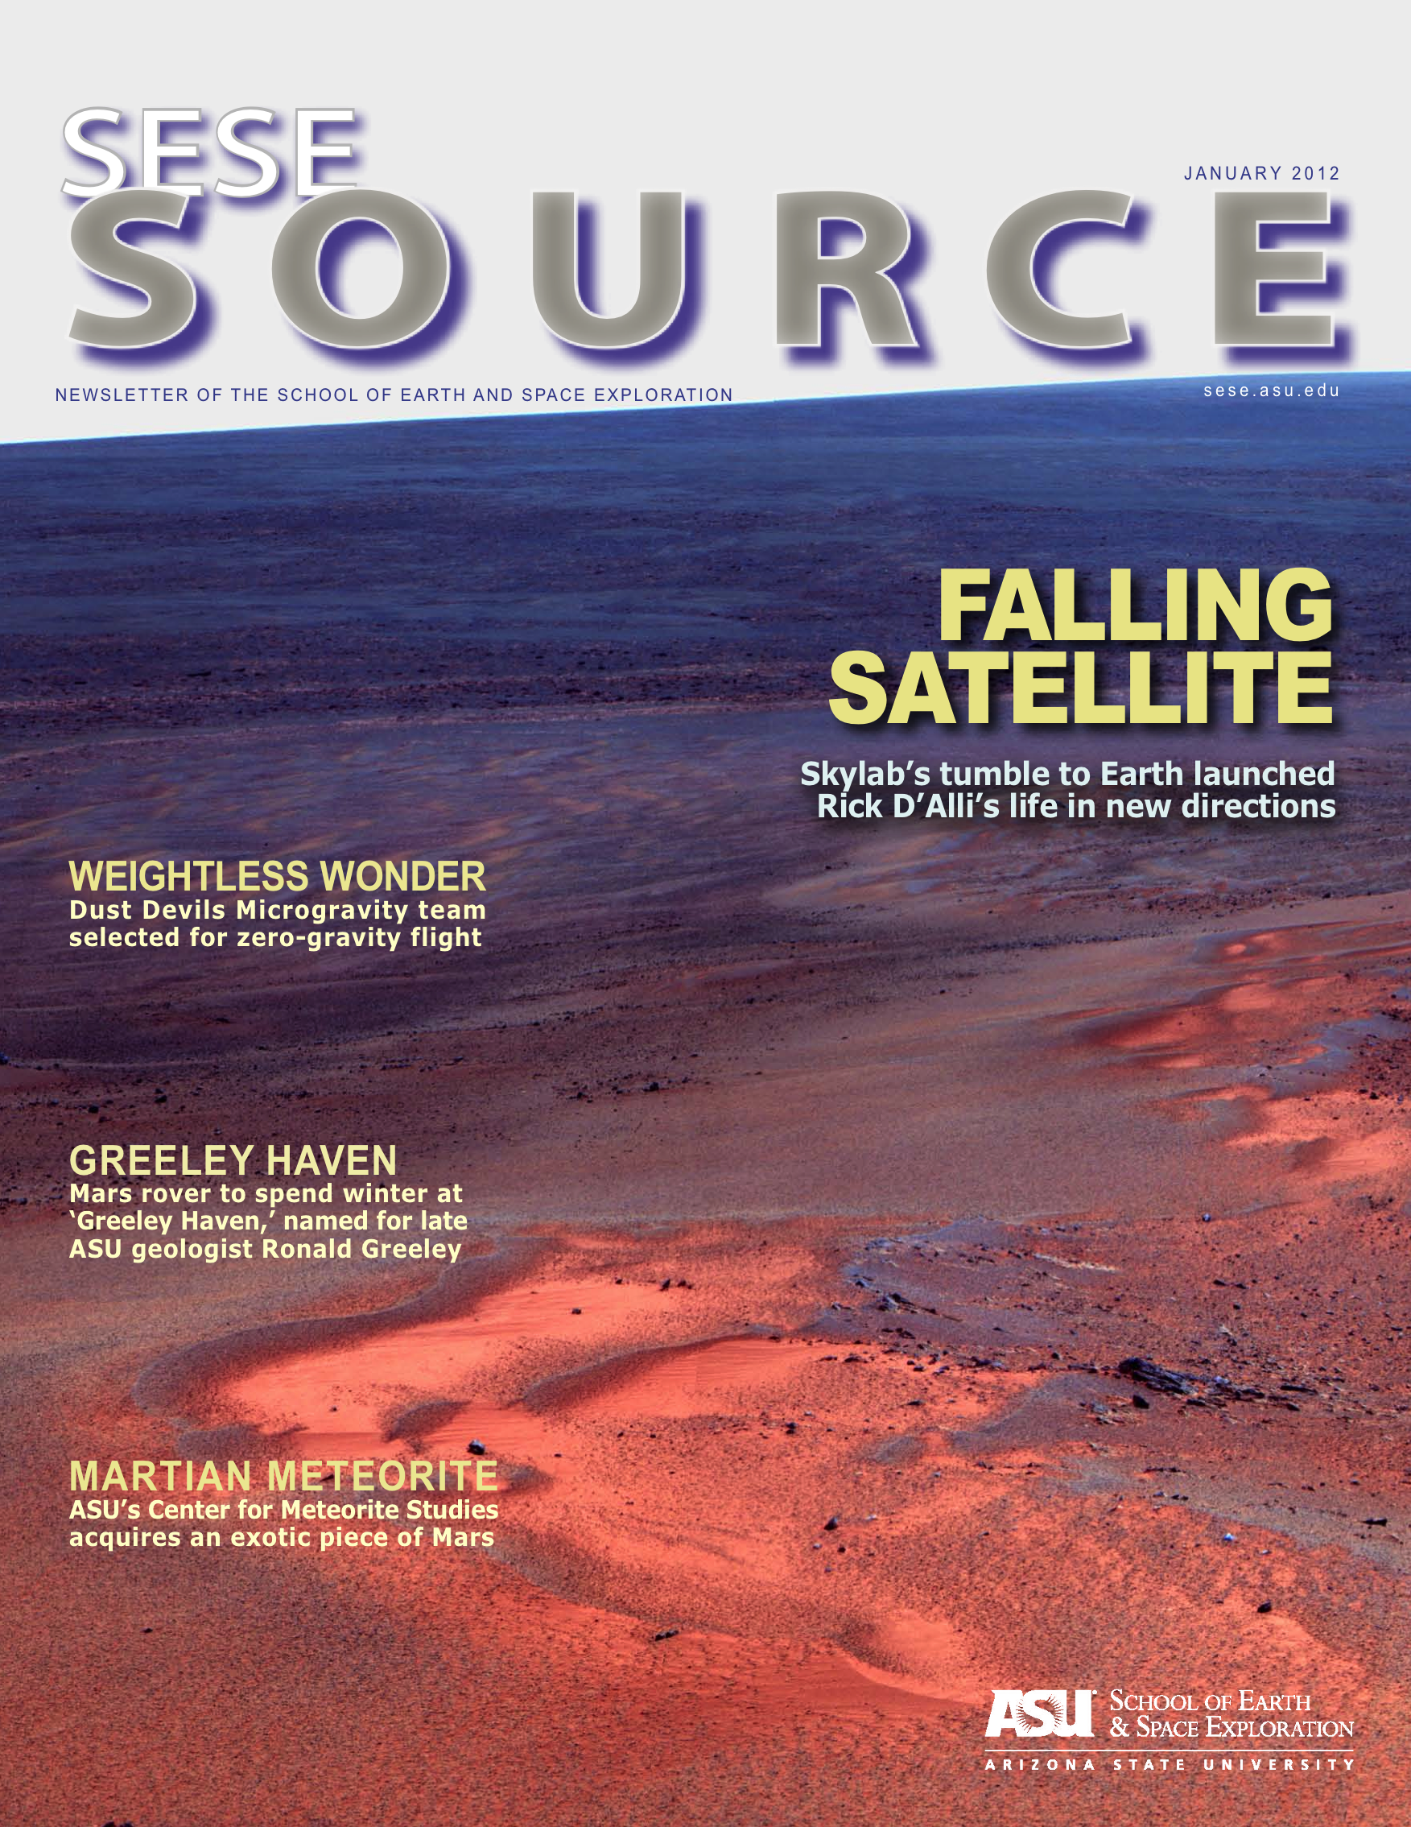

Slide 4
Interviewing Scientists
Importance of background research and preparation prior to interview
Asking the right questions: who, what, when, where, why, how?
Formulating open-ended and thought-provoking questions to elicit helpful answers
Formulating a list of questions, but also adding questions for clarification and unexpected new information during interview

Slide 5
Story Organization
Importance of structure for clarity
Potential for misleading audience through poor organization
Structuring stories about research by the scientific method
Organizing profiles around central themes or overarching concepts

Slide 6
Details and Selection
Inclusion of sensory details to reach lay audiences unfamiliar with implications of the science discussed
Importance of selecting certain aspects to include and others to omit to accurately and succinctly represent whole study or story

Slide 7
Defining Terms
Defining jargon comprehensively for general audience, but succinctly enough for specialized audience
Explaining concepts addressed to maximize understanding of story’s implications
Ensuring explanations and definitions are woven into story seamlessly, rather than appearing like a science lesson

Slide 8
Avoiding Misinterpretation
Predicting potential ways for audience to misinterpret information and structuring story to avoid confusion
Answering or addressing any questions the story or study brings to mind
Imagining questions an audience member might have answer reading the story

Slide 9
Emphasis on Significance
Structuring stories to focus on why the research or science or person is important: why should both a general audience member or a specialized scientist care?
Connecting stories to real life and showing the relevance of studies to audience members’ lives
Emphasizing the story’s most important implications and ending on this note

Slide 10
Thank You

